Slide 1

Project 2
Uday Kiran and Carson Melton

Slide 2

The Problem
Given a disk image as parameter input, create code that will recover the following file types and their SHA256 hash using the associate file header
MPG, PDF, BMP, GIF, JPG, DOCX, AVI, PNG, ZIP

Slide 3
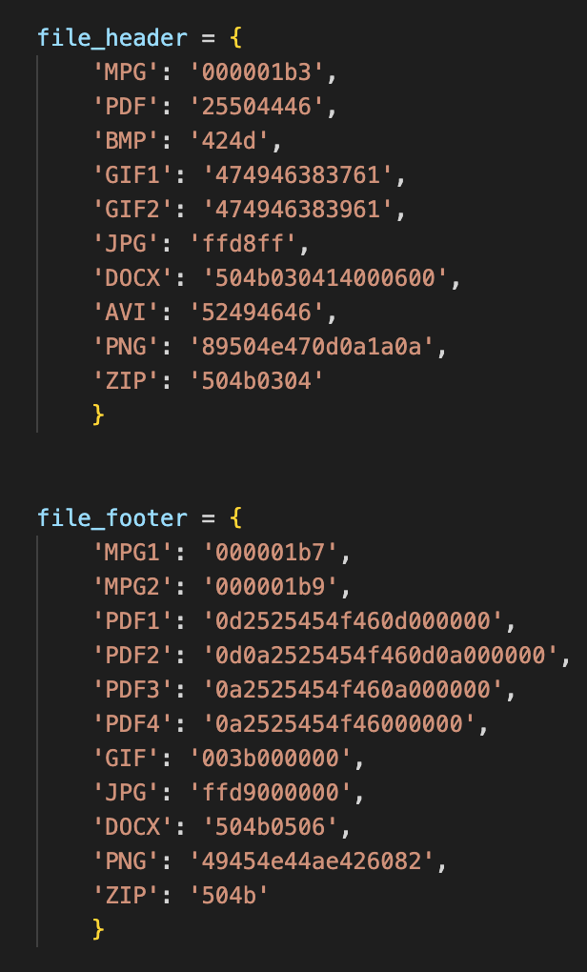
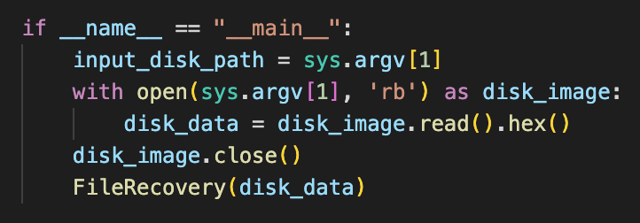
File Identification

Slide 4
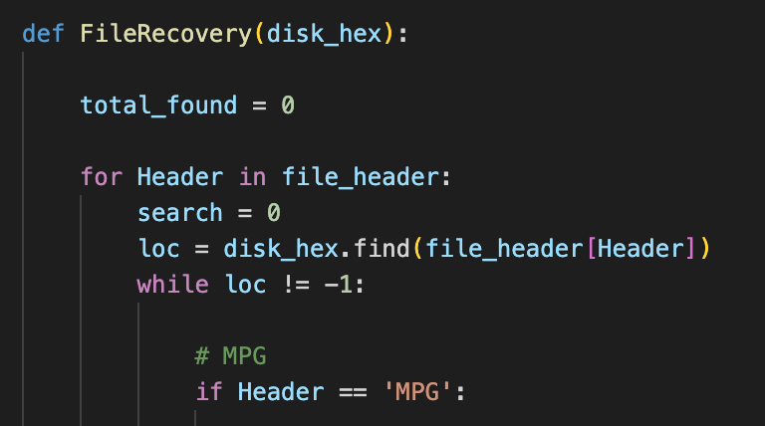
Data Traversal

Slide 5
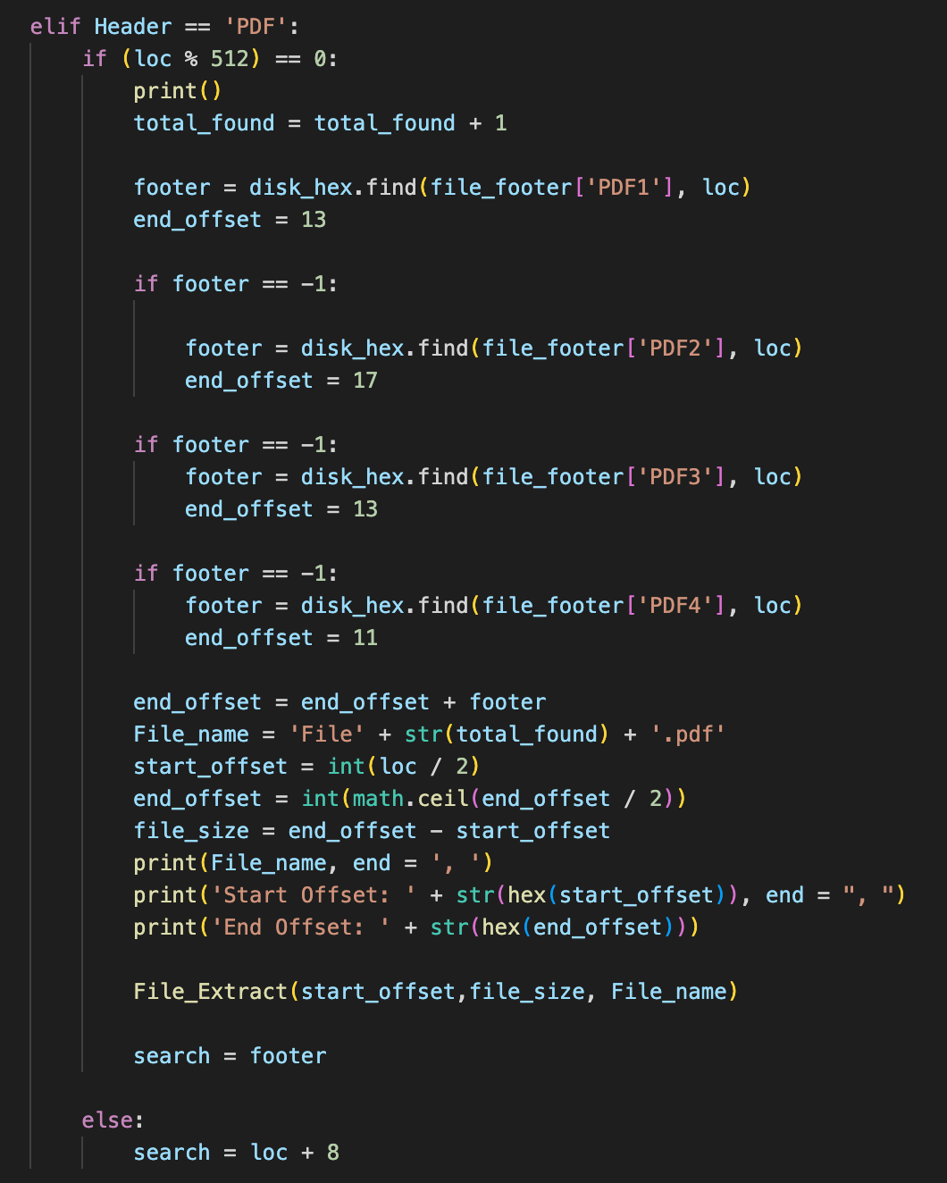
File Size Calculation
The file recovery process employs file footers to identify the end of the file
Due to PDF’s multiple file footers, the footer check is executed several times before the size is calculated

Slide 6
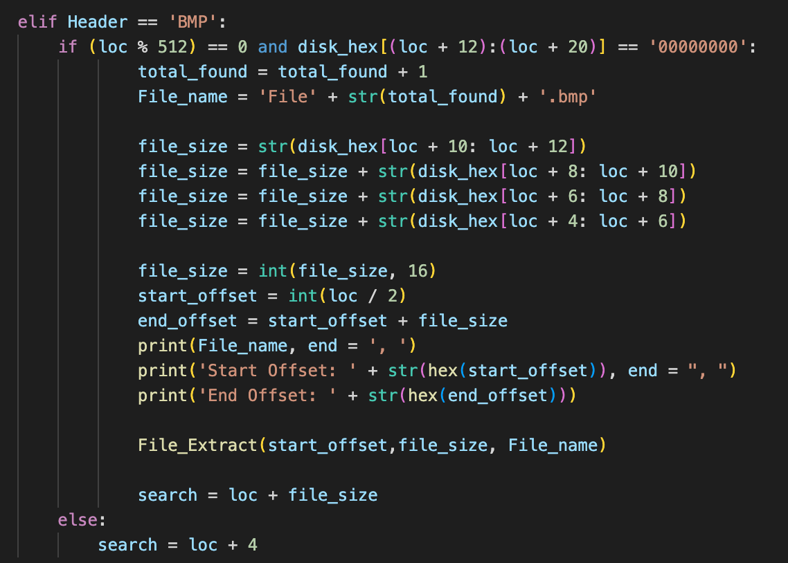
Special Cases
Because BMP and AVI files do not contain a file footer, the size of the file is stored within the file header
This information is recovered in little endian order from the file header to be used in extraction

Slide 7
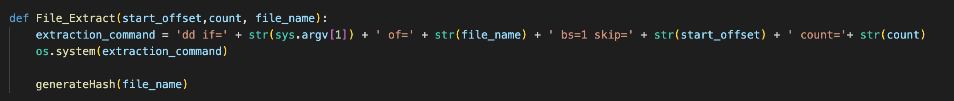
File Recovery

Slide 8
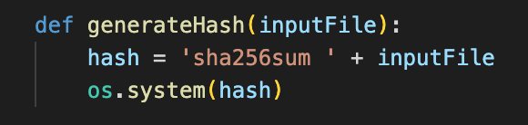
SHA256 Hash Generation
Hash generation is done using the pre-existing ‘sha256sum’ command

